Slide 1

Mobile App Development using Flutter
Introduction to Flutter – Day 1
Build Apps for any screen
Dept. of CS&E, MSRIT
Notes:
‹#›

Slide 2

Contents
Smartphone, SDK
History of Flutter
Introduction to flutter
Why Flutter for App Development
App that are build using Flutter
Advantages of flutter
Flutter Architecture
Installation of Flutter in different Platform
Run first flutter application.
How flutter compiles
Folder Structure in flutter application
Write your first App
Change the screen colors and fonts
Exercise
Dept. of CS&E, MSRIT

Slide 3
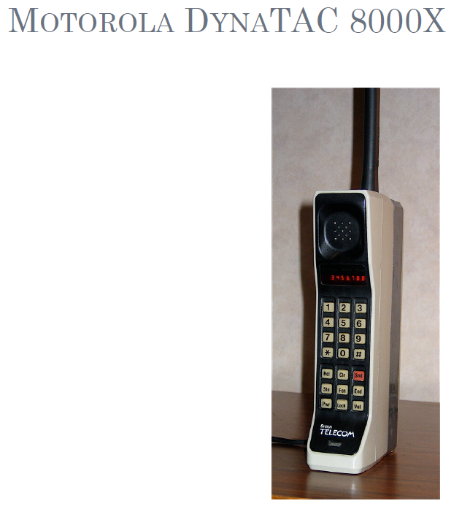
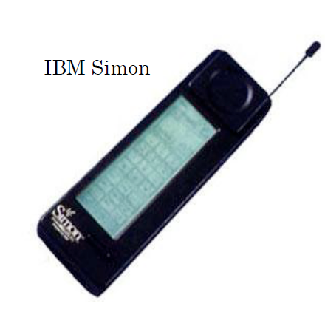
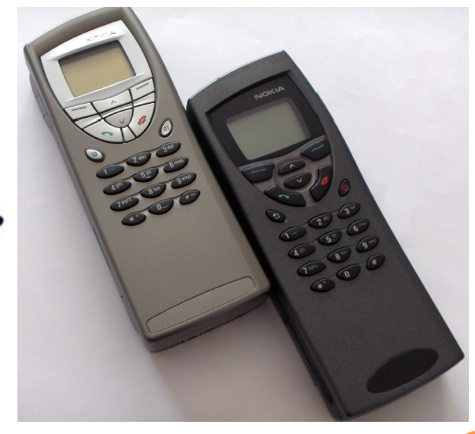
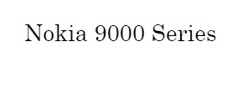

Slide 4
What is smart phone
Semi-smart: Phone that offers features beyond making calls
E-Mails
Take pictures
Play mp3
….
Phone that runs a complete OS
Offers a standardized platforms for development
Able to execute arbitrary 3rd party applications
Dept. of CS&E, MSRIT

Slide 5
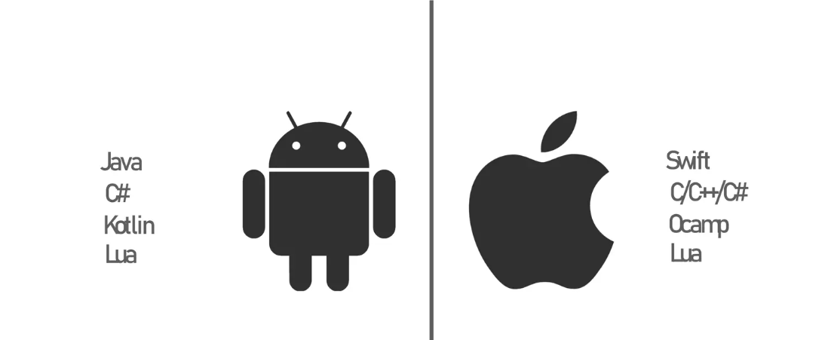

Mobile App Development
Dept. of CS&E, MSRIT

Slide 6

What is SDK
Software Development Kit (SDK or DevKit) is typically a set of software development tools that allows the creation of applications for a certain software package, software framework, hardware platform, computer system, video game console, operating system or similar development platform.
Flutter support different SDKs----example Flutter sdk, android sdk, jdk etc..
Dept. of CS&E, MSRIT

Slide 7
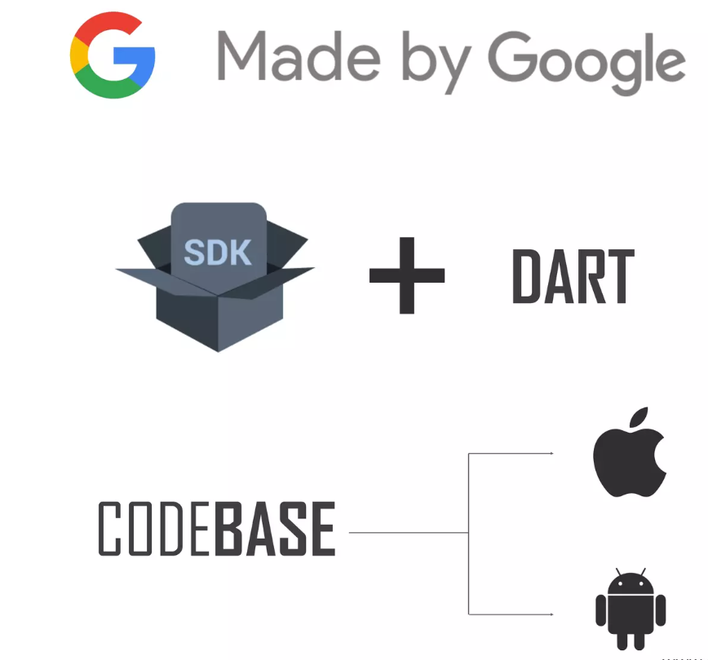
Flutter
Dept. of CS&E, MSRIT

Slide 8
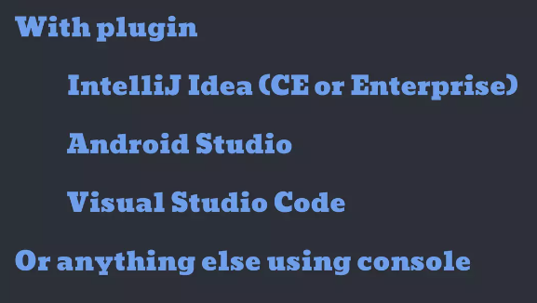
Editor
Dept. of CS&E, MSRIT

Slide 9

Brief History of Flutter
In October 2014, the team of Google developers heard the call to 'Open The Sky,' and thus The Sky Engine was born.
With time, it evolved into what we know today as Flutter - an open source UI development kit that has taken the mobile app development world by storm.
The world of mobile app development was forever changed when Multi-platform Development with Co-creator of Flutter, Eric Seidel - Semaphore one of the co-founders of Flutter, made the official announcement at the DART dev summit in April 2015.
Dept. of CS&E, MSRIT

Slide 10
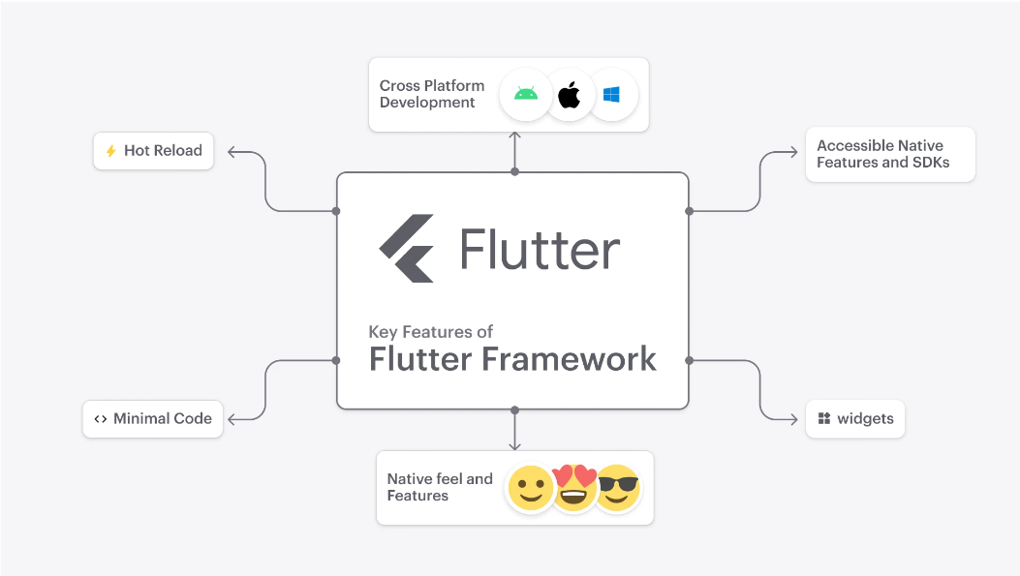
In its early days, Flutter had only one major feature - Hot Reload on Android phones.
Yet, even this single feature was a game-changer, reducing Android app creation time from a grueling 7 minutes to a mind-boggling 400ms.

Slide 11
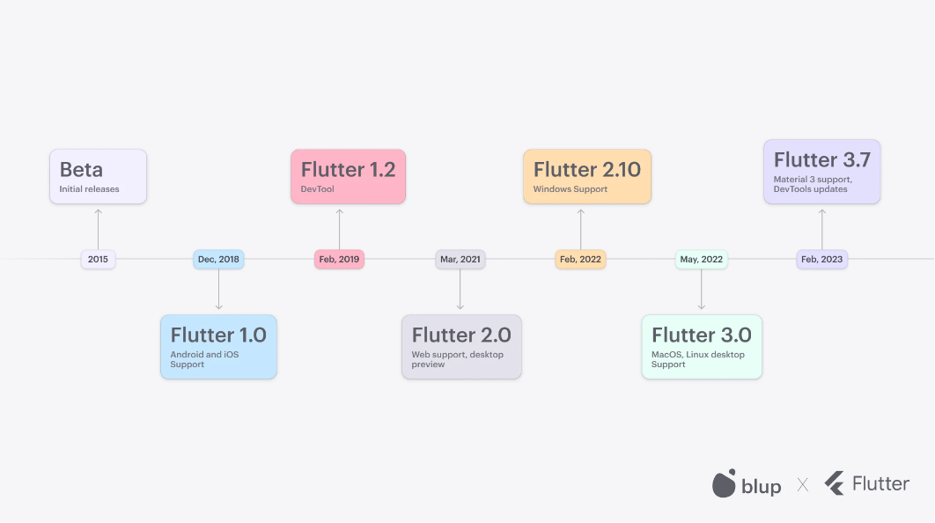
Timeline of Flutter’s development history
Flutter's journey to becoming the premier mobile app development platform was not without its share of legal battles and technological advancements.
In the span of just a few years, the platform went from being called the Sky Engine to Flutter, (courtesy of few lawyers 🧑‍⚖️).
Dept. of CS&E, MSRIT

Slide 12
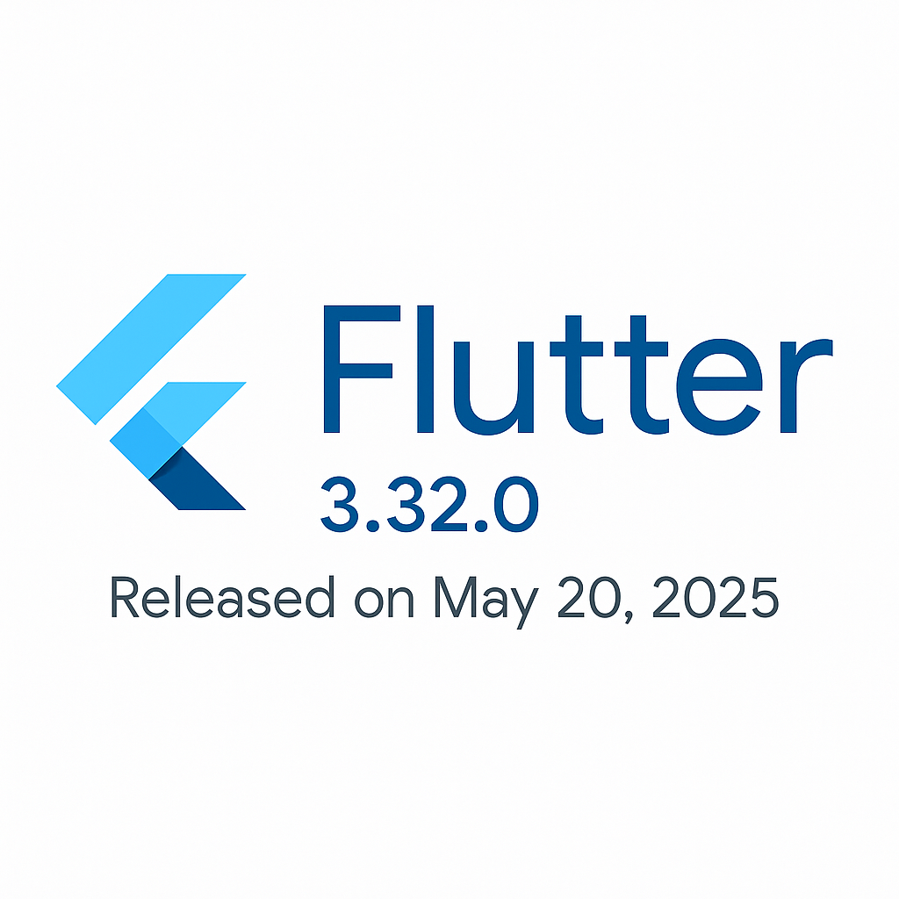
Latest Version
Dept. of CS&E, MSRIT

Slide 13
Introduction
Flutter is an open-source mobile application development framework created by Google.
It allows developers to build high performance, natively compiled applications for mobile, web and desktop from a single codebase.
Flutter uses the Dart Programming language, which is also developed by Google.
Dept. of CS&E, MSRIT

Slide 14
Why Flutter for App Development
Flutter open source: Flutter is Open-Source framework. Therefore, anyone can use it for any given purpose.
Faster development Cycle: Flutter is so fast that it takes less then 30 sec for first full compilation. Comes with Hot-Reload & Hot-Restart.
Super Productive: Comes with Hot-Reload & Hot-Restart. Due to Stateful widget hot-reload feature Flutter is very fast iterative coding style.
Dept. of CS&E, MSRIT

Slide 15
Why Flutter for App Development
Ease to learn & code sharing: Any one who have basic knowledge of OOPS Concept & UI Designing can easily learn Flutter.
Widget Libraries: Ready to use widget, Flutter have many widget that you can use to build flutter application.Such as : http, get, share plus, toggle switch etc.
Community Support: Flutter Community is bit small if we compare with other framework like React, But Flutter is grow very fast than other framework.
Dept. of CS&E, MSRIT

Slide 16
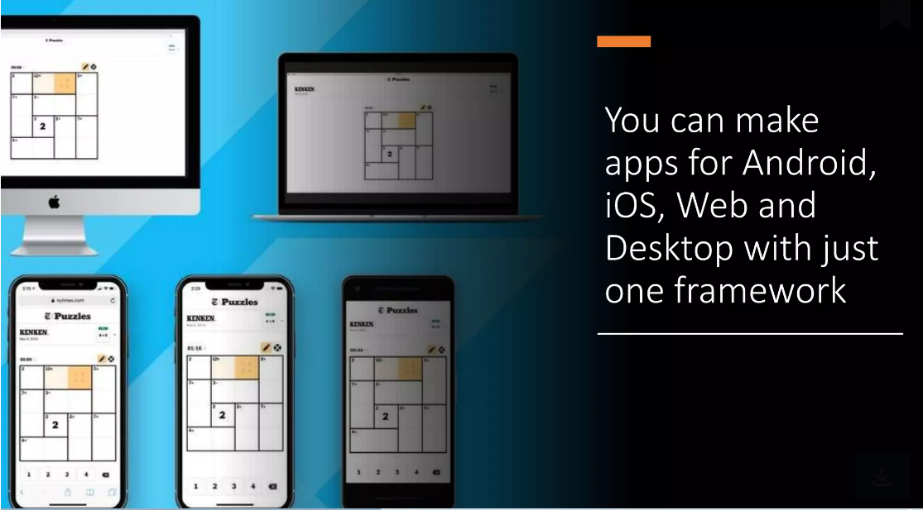

Slide 17
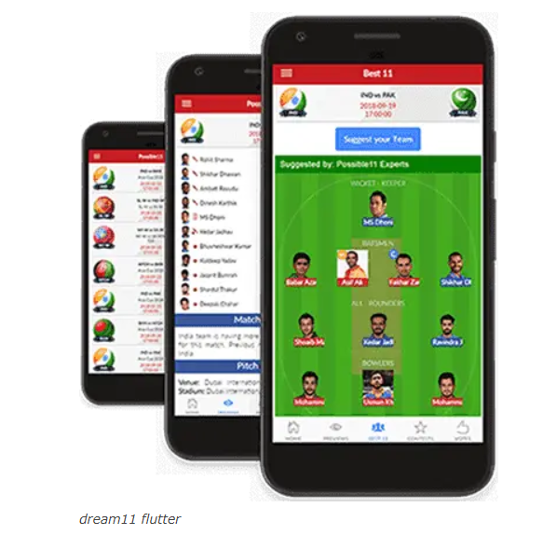
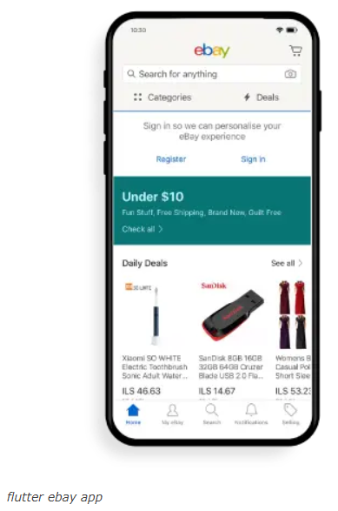
App that are build using Flutter
1. Dream 11 2. eBay
Dept. of CS&E, MSRIT

Slide 18
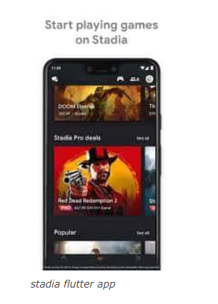
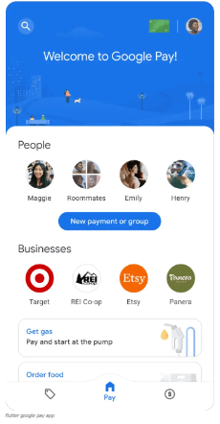
App that are build using Flutter
3. Stadia gaming Platform 4. Google Pay – UPI Payment App
Dept. of CS&E, MSRIT

Slide 19
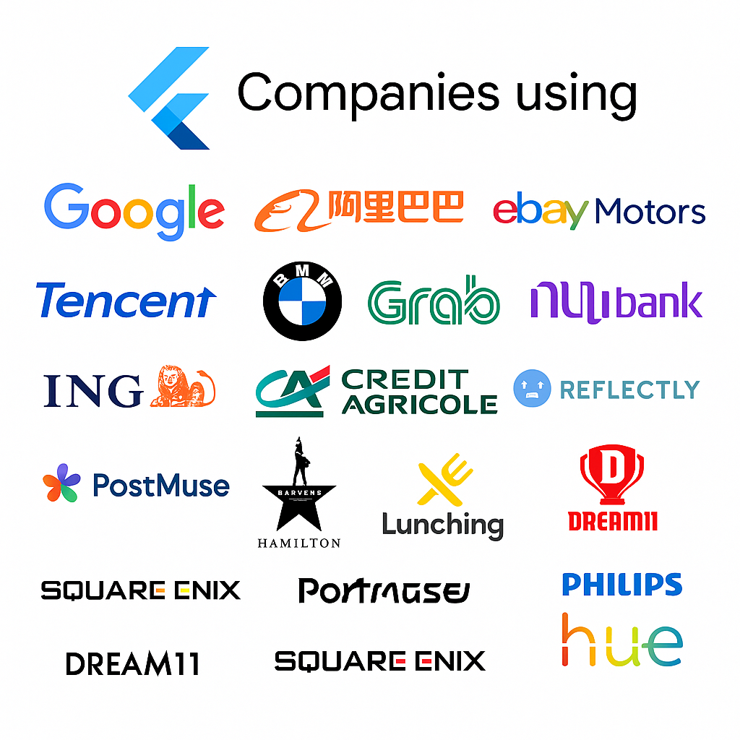
List of companies using Flutter
Dept. of CS&E, MSRIT

Slide 20
Advantages of Flutter
Single Codebase for Multiple Platforms
Write once, deploy to Android, iOS, Web, Windows, macOS, and Linux.
Hot Reload & Hot Restart
Instantly see UI and logic changes without restarting the app.
High Performance
Compiles to native ARM code using Dart, ensuring smooth animations and fast execution.
Beautiful & Customizable UI
Rich widget library (Material, Cupertino) and support for custom designs.
Strong Community & Google Backing
Large ecosystem, active developers, and long-term support from Google.
Rich Set of Plugins & Packages
Easy integration with device APIs, Firebase, AI services, and more.
Native-like Experience
Consistent UI/UX across platforms while feeling native to each OS.
Open Source & Free
No licensing costs, supported by an active open-source community.
Support for Modern Development
Null safety in Dart, adaptive layouts, and responsive design.
Easy Testing & Maintenance
Fewer bugs due to single codebase, and easier QA/testing process.
Dept. of CS&E, MSRIT

Slide 21
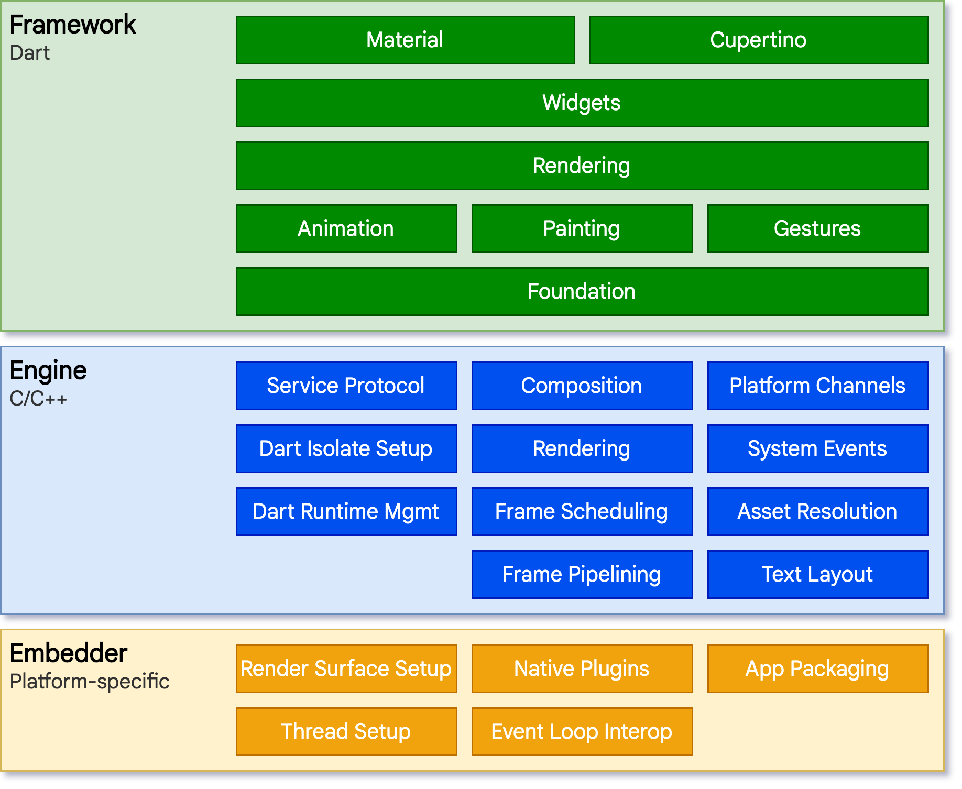
Flutter Architecture
Dept. of CS&E, MSRIT

Slide 22
Flutter Architecture
Framework (Dart)
This is the top layer where developers write most of their Flutter code in Dart. It provides ready‑to‑use tools for creating apps.
Material → Widgets following Google’s Material Design guidelines.
Cupertino → Widgets following Apple’s iOS design style.
Widgets → The building blocks for UI elements.
Rendering → Lays out and paints widgets on the screen.
Animation → APIs for creating motion and transitions.
Painting → Handles shapes, colors, images, and drawing.
Gestures → Detects user input such as taps, drags, and swipes.
Foundation → Core Dart classes, error handling, and basic building utilities.
💡 Purpose: This is the UI toolkit that you directly use when coding in Flutter.
Dept. of CS&E, MSRIT

Slide 23
Flutter Architecture
Engine (C/C++)
The middle layer written mostly in C++. It powers Flutter’s rendering and communication with native platforms.
Service Protocol → Allows debugging, profiling, and hot reload.
Composition → Combines different drawing layers into the final frame.
Platform Channels → Lets Flutter talk to native Android/iOS code.
Dart Isolate Setup → Manages Dart threads for concurrent execution.
Rendering → Uses Skia graphics library to draw UI.
System Events → Handles device-level events (e.g., screen rotation).
Dart Runtime Management → Runs Dart code.
Frame Scheduling → Optimizes rendering speed.
Asset Resolution → Finds the right images/fonts for device resolution.
Frame Pipelining → Ensures smooth frame rendering.
Text Layout → Handles text measurement, font rendering, and direction.
💡 Purpose: This is the high-performance rendering core of Flutter.
Dept. of CS&E, MSRIT

Slide 24
Flutter Architecture
Embedder (Platform-Specific)
The bottom layer that’s specific to each operating system (Android, iOS, Windows, macOS, Linux, Web).
Render Surface Setup → Creates the surface for rendering (e.g., Android SurfaceView).
Native Plugins → Enables access to native device capabilities (camera, GPS).
App Packaging → Bundles the Flutter app into a native app package (.apk, .ipa).
Thread Setup → Manages UI, rendering, and platform threads.
Event Loop Interop → Connects Flutter’s event loop with the OS event loop.
💡 Purpose: This glues Flutter to the operating system, making the app run as a native app.
Dept. of CS&E, MSRIT

Slide 25
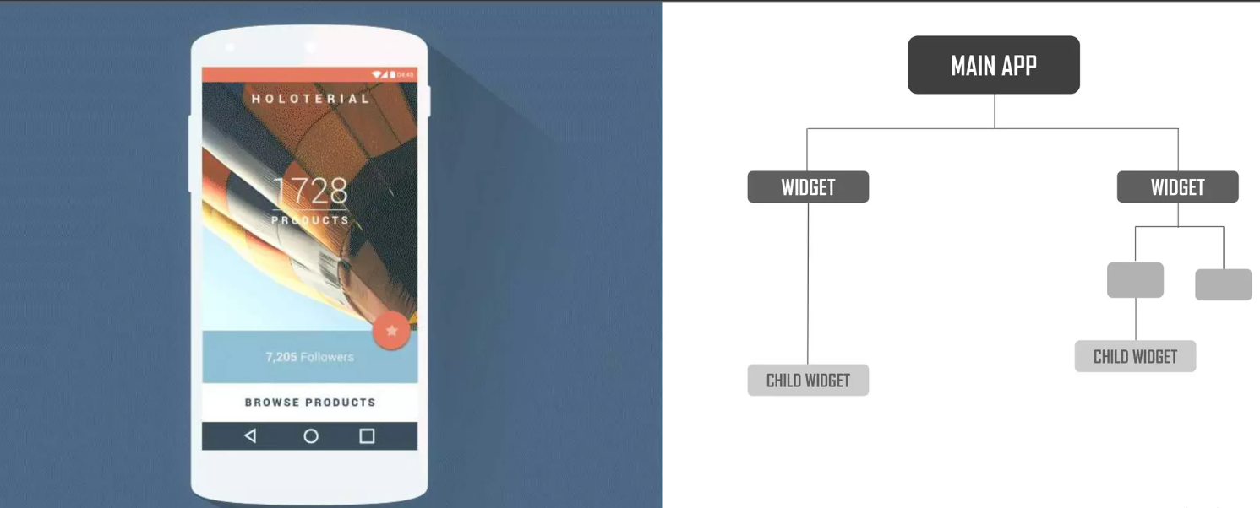
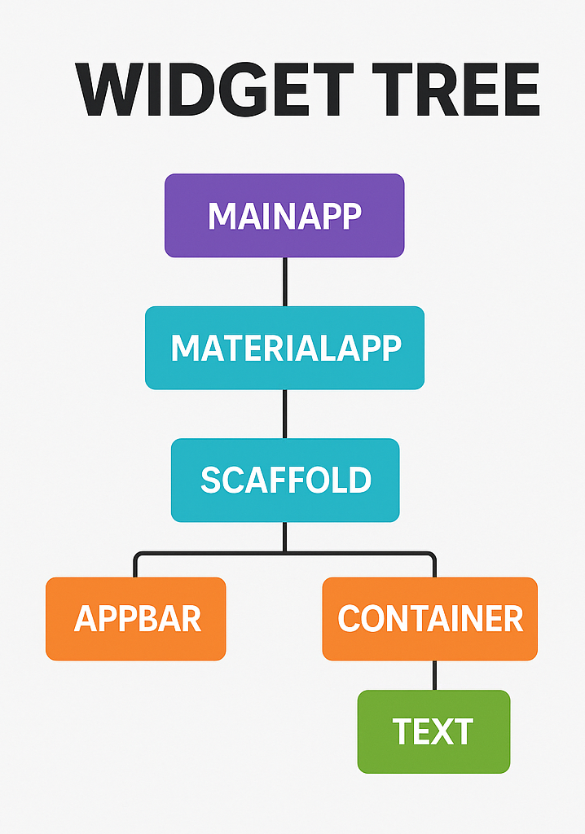
Flutter Architecture
Dept. of CS&E, MSRIT

Slide 26
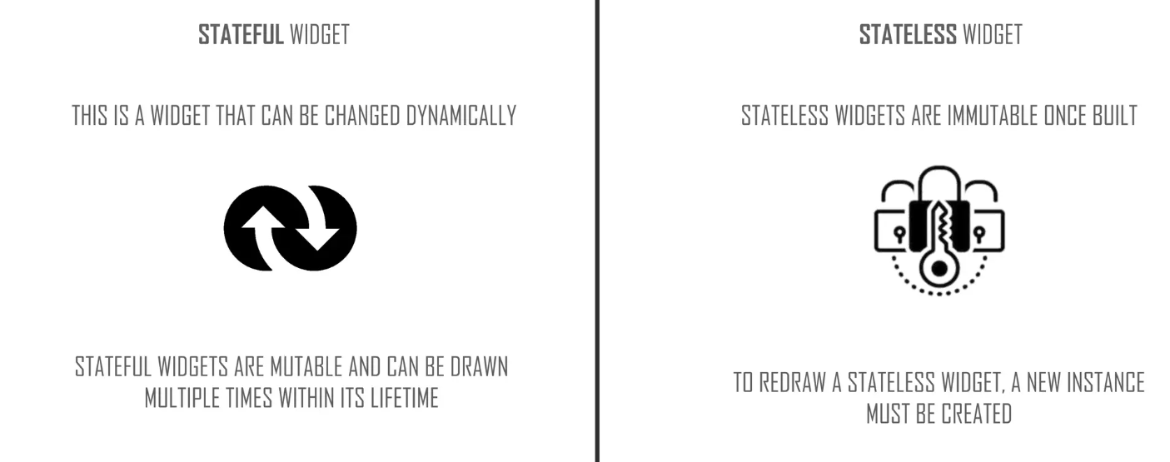
Types of Widgets
Dept. of CS&E, MSRIT

Slide 27
Setting up the development environment for Flutter
Prerequisites:
1. Operating System: Flutter supports Windows, macOS, and Linux. Ensure your system meets the minimum requirements for your chosen platform.
2. Visual Studio Code: Download and install Visual Studio Code from https://code.visualstudio.com/Download
Dept. of CS&E, MSRIT

Slide 28
Setting up the development environment for Flutter
cselab3@cselab3:~$ sudo apt update && sudo apt upgrade -y
Dept. of CS&E, MSRIT

Slide 29
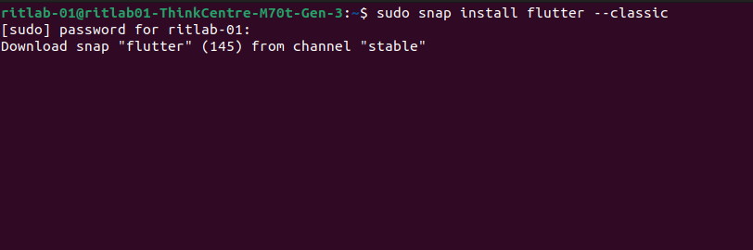
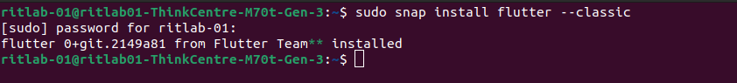
Setting up Flutter SDK in Terminal
Open Terminal type the command: sudo snap install flutter –classic
Dept. of CS&E, MSRIT

Slide 30
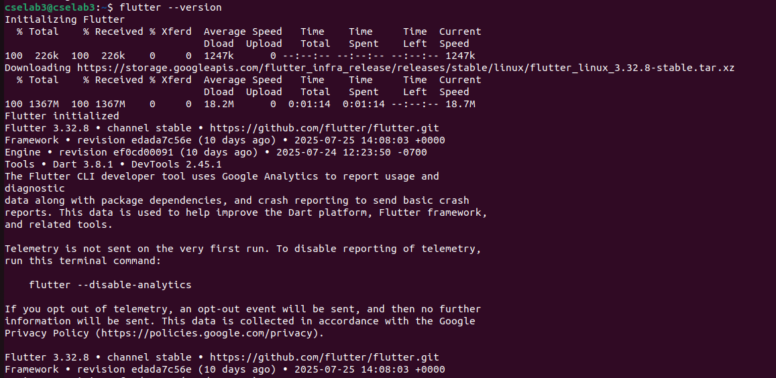
Setting up Flutter SDK in Terminal
Check for the flutter version: flutter –version
Once installed, open vscode
Dept. of CS&E, MSRIT

Slide 31
Setting up the development environment for Flutter
Step:1 Install Visual Studio Code Extensions
Install Flutter and Dart Extensions:
Open Visual Studio Code.
Go to Extensions (or press Ctrl + Shift + X).
Search for "Flutter" in the Extensions marketplace and install the official Flutter extension by Dart Code.
Similarly, search for "Dart" and install the Dart extension by Dart Code.
Step-2: Verify Flutter Setup
1. Restart VS Code:
After installing the Flutter and Dart extensions, restart Visual Studio Code.
2. Open a Flutter Project:
Open the terminal in the VsCode
Create a new Flutter project using flutter create myapp (replace "myapp" with your project name).
Open the project folder in VS Code.
3. Run the App:
Open a terminal inside VS Code.
Navigate to your project directory using the cd command.
Run flutter run to build and launch your Flutter app on a connected device/emulator.
Dept. of CS&E, MSRIT

Slide 32
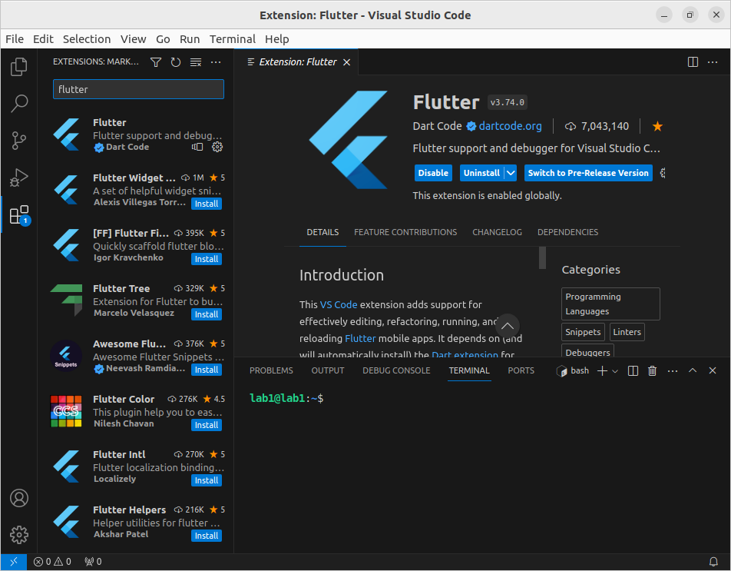
Ubuntu installation of flutter
Dept. of CS&E, MSRIT

Slide 33
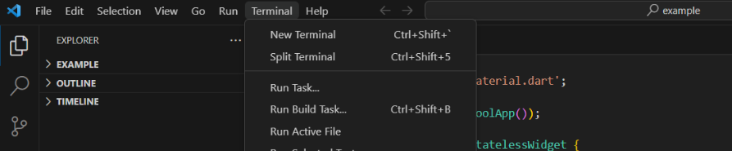
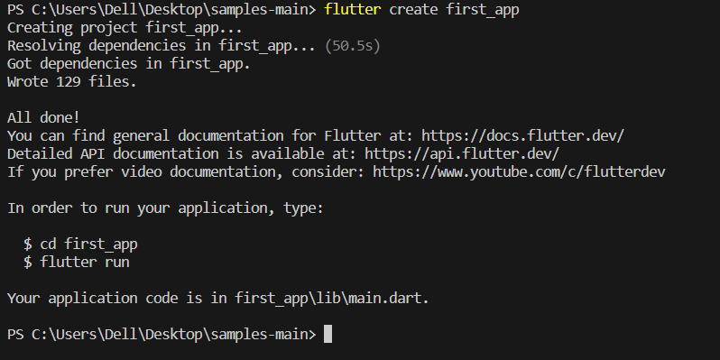
Creation of first_app flutter
Open VSCode
New terminal
2. Type flutter create first_app
Dept. of CS&E, MSRIT

Slide 34
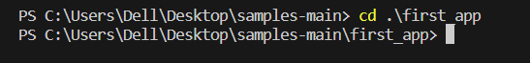
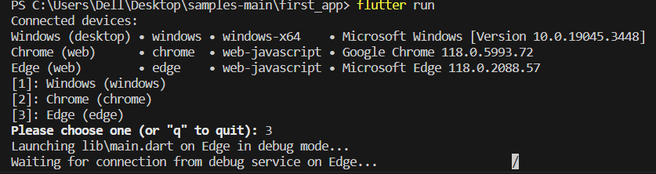
Creation of first_app flutter
3. Travel to the created package first_app by typing cd first_app.
4. Run the flutter app --- flutter run
Ask for where to display the output
Select 2/3 where ur app need to be shown.---3
Dept. of CS&E, MSRIT

Slide 35
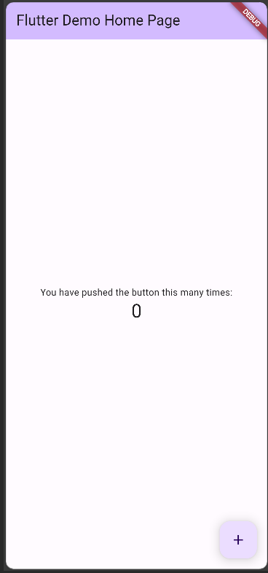
Output of first_app flutter app
Dept. of CS&E, MSRIT

Slide 36
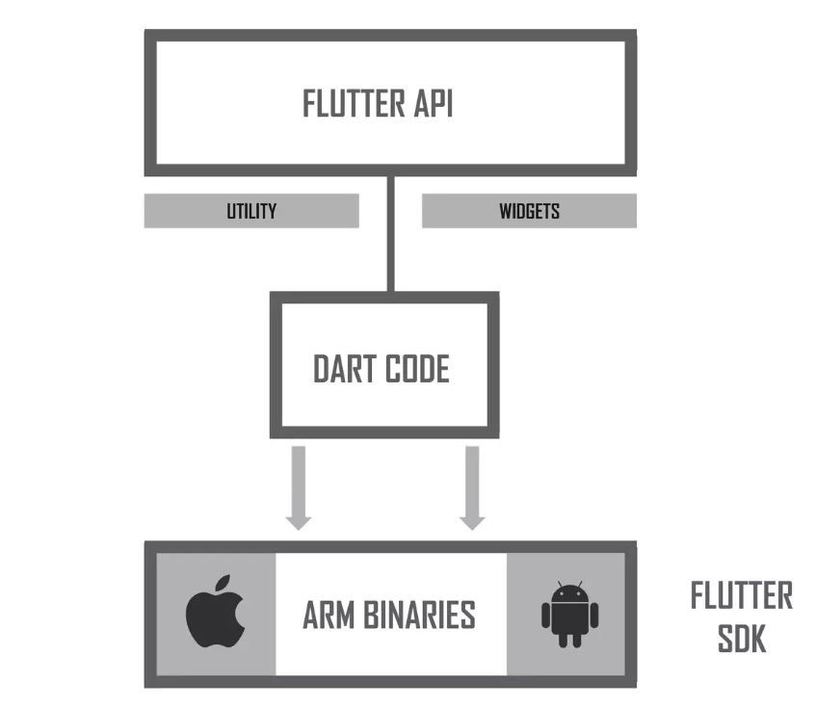
How flutter compiles
Dept. of CS&E, MSRIT

Slide 37
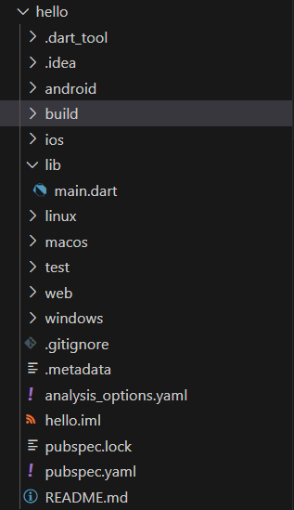
Folder structure in flutter application
.dart tool--- specifies dart language usage
.idea----Holds configuration files for android studio
Android--- These folders contain platform-specific code for Android
ios --- These folders contain platform-specific code for iOS.
lib --- The lib folder is where most of your Flutter application code resides. It contains Dart files that define your app's functionality, UI components, and logic.
Dept. of CS&E, MSRIT

Slide 38
Folder structure in flutter application
lib=---
main.dart: The entry point of your Flutter app. It typically contains the main() function where the app starts executing.
Other Dart Files: You can create additional Dart files to organize your code. For example, you might have files for different screens, components, or utility functions.
test ---The test folder contains unit tests and integration tests for your application. Writing tests is crucial for ensuring the correctness and reliability of your code.
Dept. of CS&E, MSRIT

Slide 39
Folder structure in flutter application
Web(optional) --This folder is present in Flutter projects that support web development. It contains web-specific files and configurations. Flutter allows you to target the web platform, and the web folder holds web-specific entry points and assets
.gitignore--- The .gitignore file specifies files and directories that should be ignored by version control systems like Git. It helps keep your repository clean by excluding generated files, build artifacts, and other non-essential files.
Dept. of CS&E, MSRIT

Slide 40
Folder structure in flutter application
Pubspec.yaml --The pubspec.yaml file is a crucial file that contains metadata about the Flutter project. It includes dependencies, assets, Flutter version, and other project-specific configurations. You define your app's name, description, version, and dependencies (packages from Dart's package repository) in this file
build--- The build folder is automatically generated by Flutter. It contains intermediate build files and artifacts. You generally don't need to interact with this folder directly.
Dept. of CS&E, MSRIT

Slide 41
Folder structure in flutter application
Exercise to be done
Navigate to lib folder
Open main.dart
Dept. of CS&E, MSRIT

Slide 42
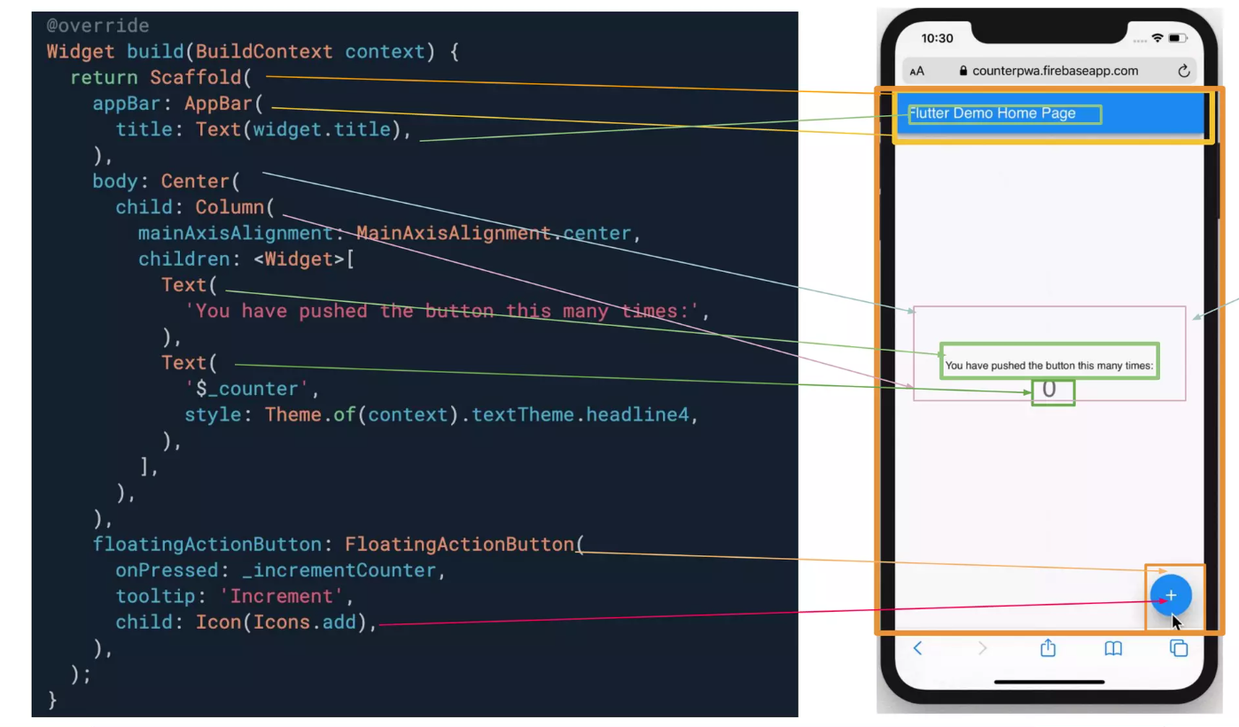

Slide 43
Write your first hello app
Delete the default code of main.dart file
Add the following code given in the next slide
Dept. of CS&E, MSRIT

Slide 44
Write your first hello app
import 'package:flutter/material.dart';
void main() {
runApp(first_app());
}
class first_app extends StatelessWidget {
@override
Widget build(BuildContext context) {
// Material App
return MaterialApp(
// Scaffold Widget
home: Scaffold(
appBar: AppBar(
// AppBar takes a Text Widget
// in its title parameter
title: const Text('Flutter Class'),
), // AppBar
body: const Center(
child: Text('Hello World'),
),
), // Scaffold
); // MaterialApp
}
}
Dept. of CS&E, MSRIT

Slide 45
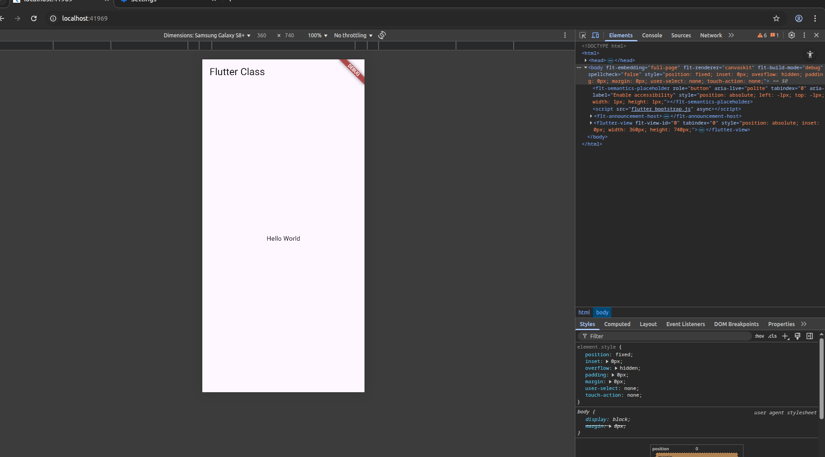

Slide 46
Pre-requisites
Need to understand the term call widgets
Basic of Dart Programming languages
Dept. of CS&E, MSRIT

Slide 47
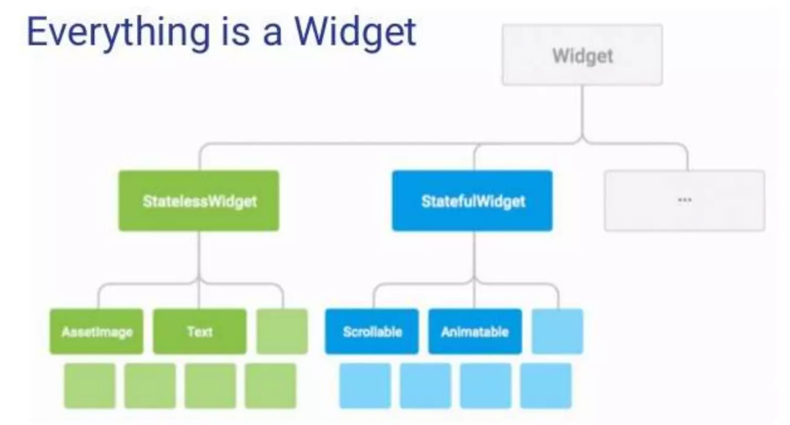
Widgets
The Flutter UI is implemented by using widgets from a modern reactive framework. Flutter uses its own rendering engine to draw widgets.
Everything in flutter consist of widgets
Dept. of CS&E, MSRIT

Slide 48
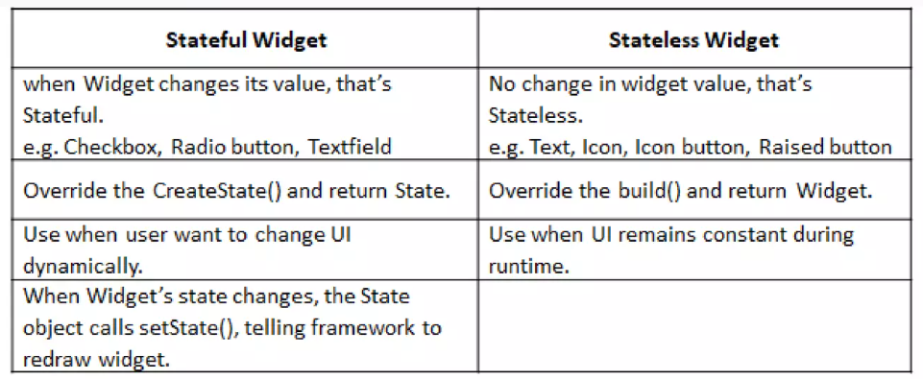
Widgets
Dept. of CS&E, MSRIT

Slide 49
Write your first hello app
Add BackgroundColor Widget to the existing app
import 'package:flutter/material.dart';
void main() {
runApp(FirstApp());
}
class FirstApp extends StatelessWidget {
@override
Widget build(BuildContext context) {
// Material App
return MaterialApp(
home: Scaffold(
backgroundColor: Colors.lightBlue[50], // 🌟 Background color added
appBar: AppBar(
title: const Text('Flutter Class'),
backgroundColor: Colors.blue, // AppBar color
),
body: const Center(
child: Text(
'Hello World',
style: TextStyle(fontSize: 20), // Optional text styling
),
),
),
);
}
}
Guess the output????????????
Dept. of CS&E, MSRIT

Slide 50
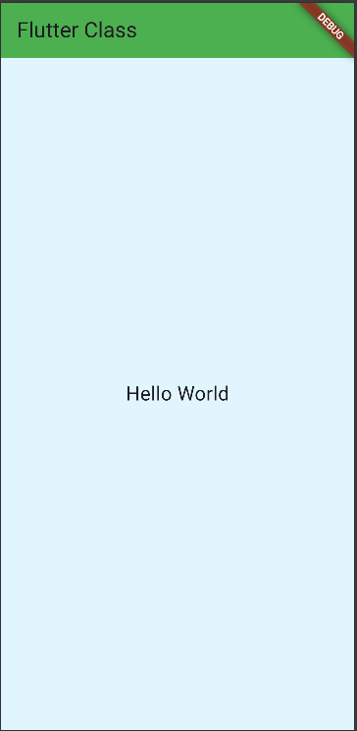
output
Dept. of CS&E, MSRIT

Slide 51
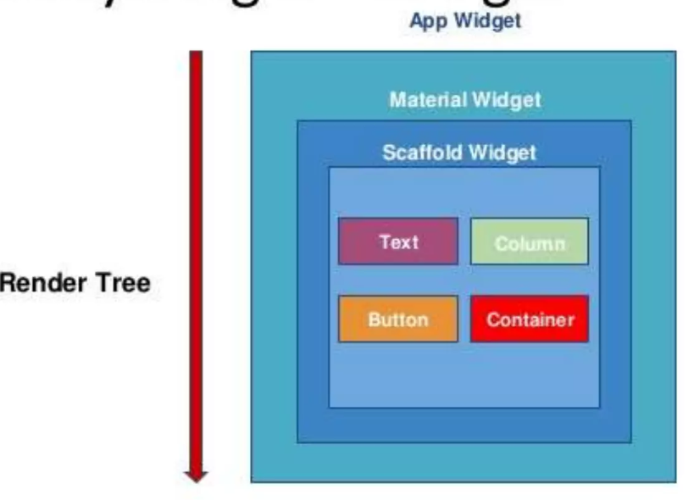
Widgets
Dept. of CS&E, MSRIT

Slide 52
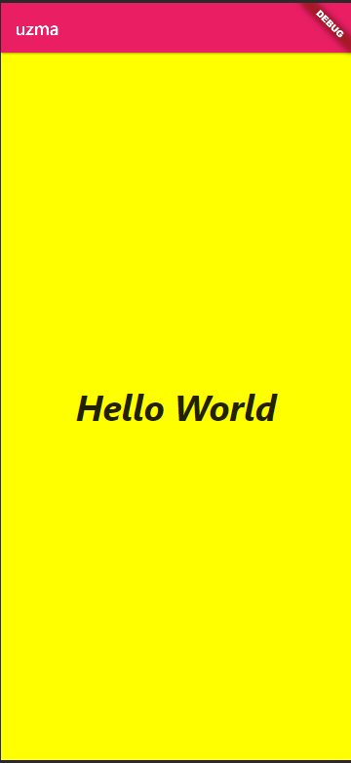
Exercise-1
Write a flutter program to display the content shown below.
Dept. of CS&E, MSRIT

Slide 53
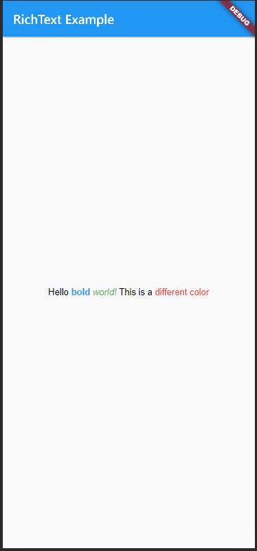
Exercise-2
2. Write a flutter program to display the content shown below.
Dept. of CS&E, MSRIT

Slide 54
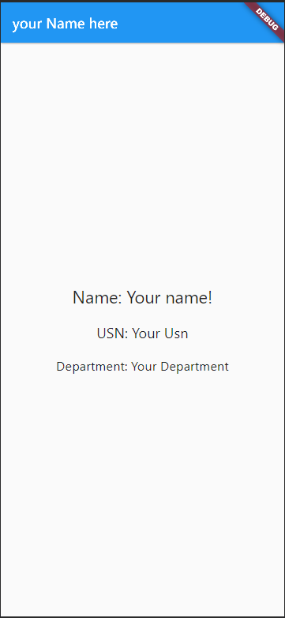
Exercise-3
3. Write a flutter program to display the content shown below.
Dept. of CS&E, MSRIT

Slide 55
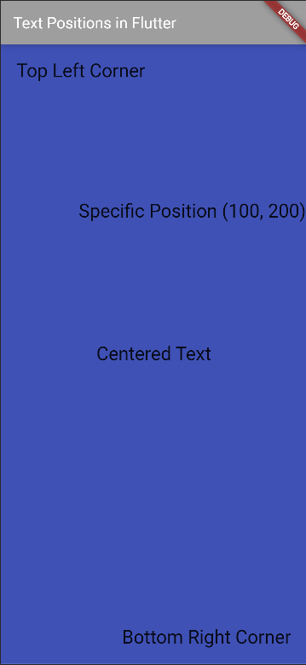
Exercise-4
4. Write a flutter program to display the content shown below.
Dept. of CS&E, MSRIT

Slide 56
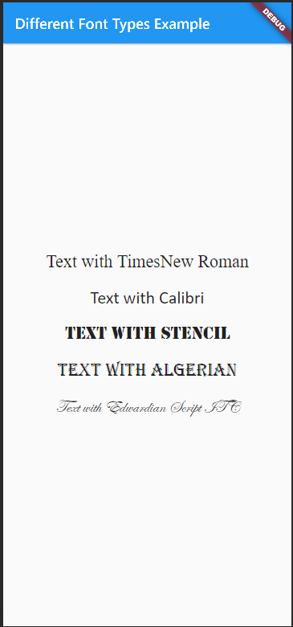
Exercise-5
5. Write a flutter program to display the content shown below.
Dept. of CS&E, MSRIT

